Slide 1

Building an Online Course Recommendation System
Mentor’s Name:
Karthik
Team Members:
Amandeep
Deepesh Kumar Verma
Kaveti Nani Kartik
BAREDDY PAVANI
MADANAPU PRATHYUSHA
MEDI SANJAY
Prasanna Sanjay Patil

Slide 2
Business Objective & Problem Statement
To build an online course recommendation system that suggests the most relevant courses
to learners based on their interests, past enrollments, and engagement patterns.
Learners struggle to find suitable courses among large options. Using data such as ratings, instructor info, study materials, difficulty level, and feedback, the goal is to create a recommendation model using collaborative, content-based, or hybrid filtering to provide personalized course suggestions.

Slide 3
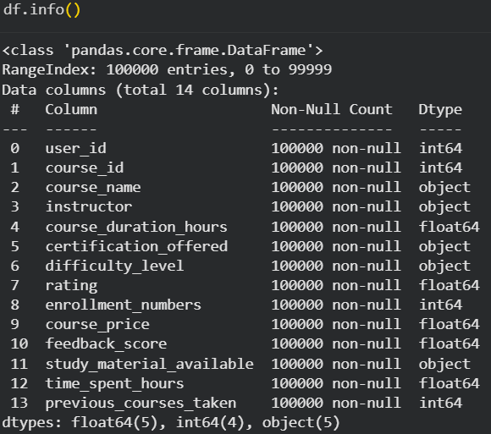
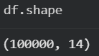
Dataset Overview:
This dataset contains detailed information about online courses and learner activity. It includes course attributes (name, instructor, duration, difficulty, price), learner interactions (ratings, time spent, previous courses), and additional indicators like certification availability, study materials, and feedback scores.
It supports building personalized course recommendation models by combining course features and learner behavior.
14
3
100+
Key Variables
Recommendation Approaches
Course Hours
Capturing learner and course attributes
Wide range of course durations
Collaborative, content-based, and hybrid

Slide 4

Course Characteristics & Offerings
1
2
3
instructor
course_duration_hours
certification_offered
String: Name of the course instructor
Float (5.0-100.0): Total course length
Yes/No: Certification availability
4
course_name
String: Descriptive title of the online course
difficulty_level
String: Beginner, Intermediate, or Advanced

Slide 5
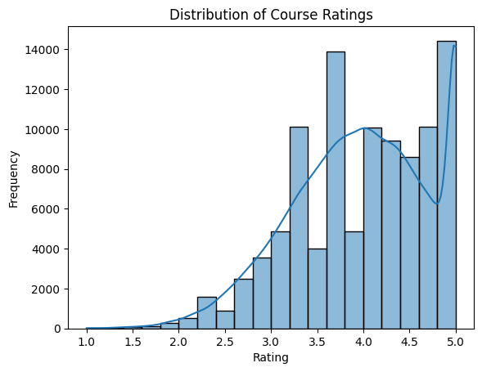
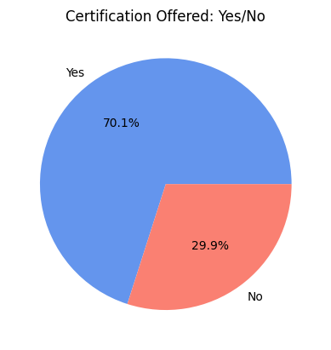
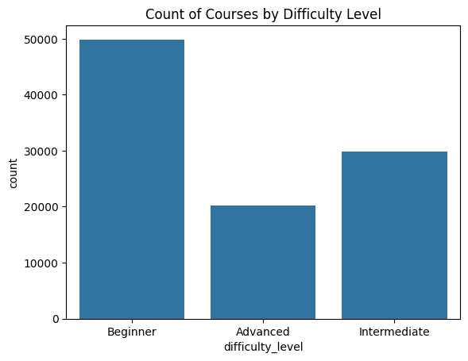
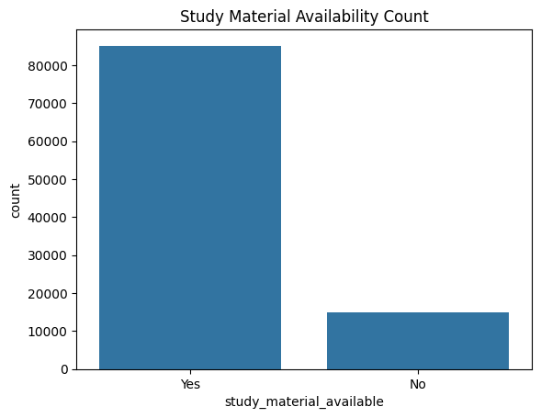
Exploratory Data Analysis

Slide 6
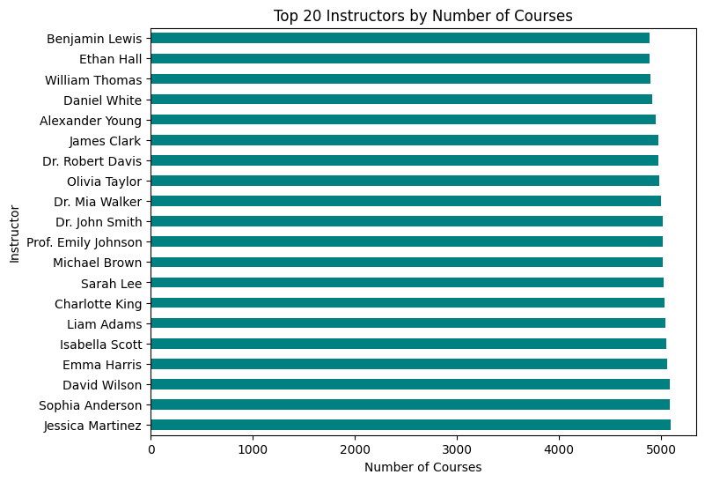

Slide 7
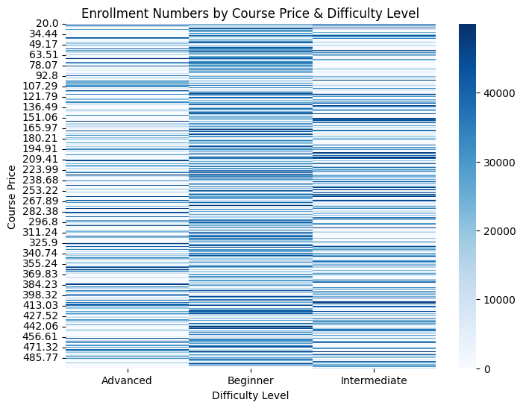
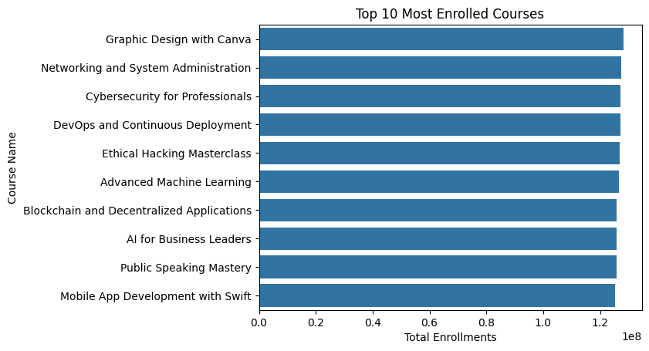

Slide 8
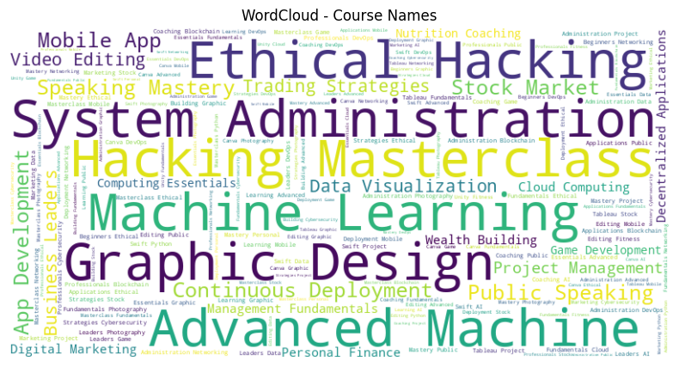
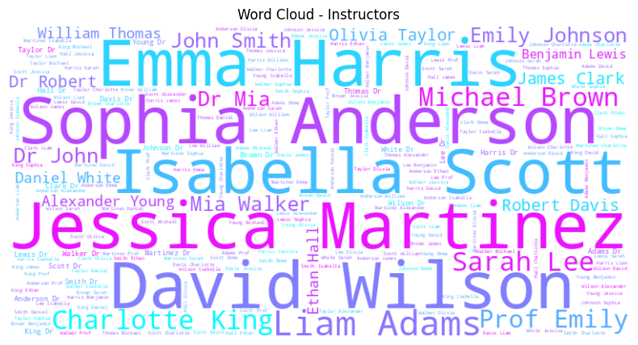

Slide 9
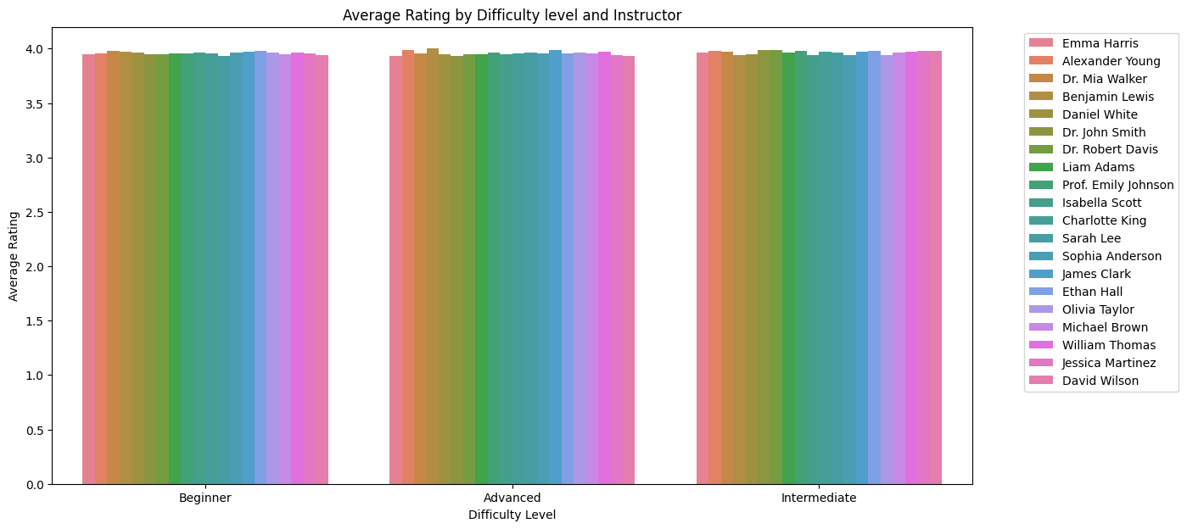

Slide 10
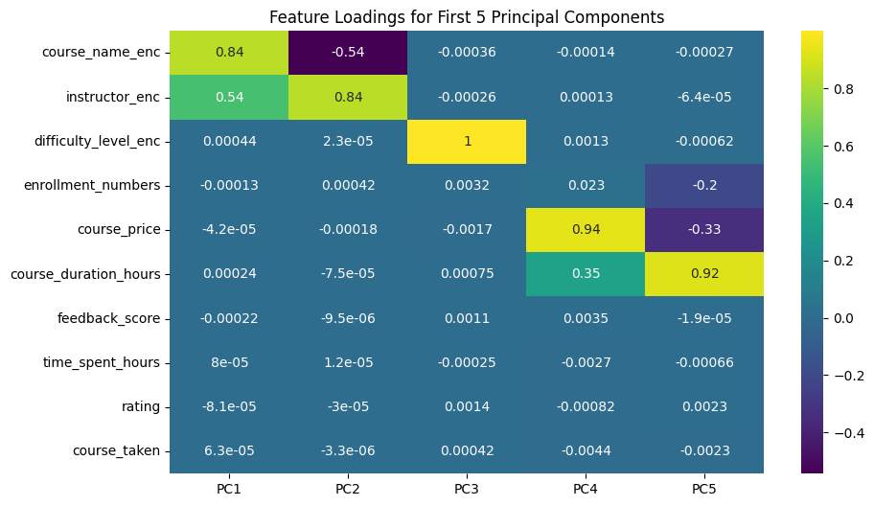
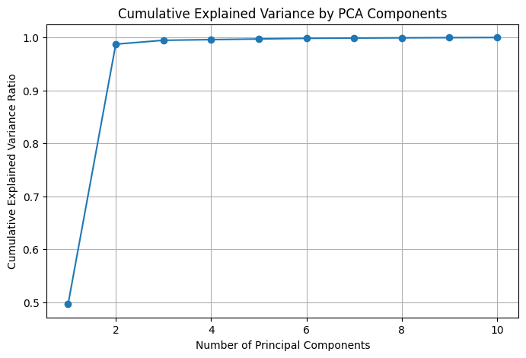
PCA & Feature Importance

Slide 11
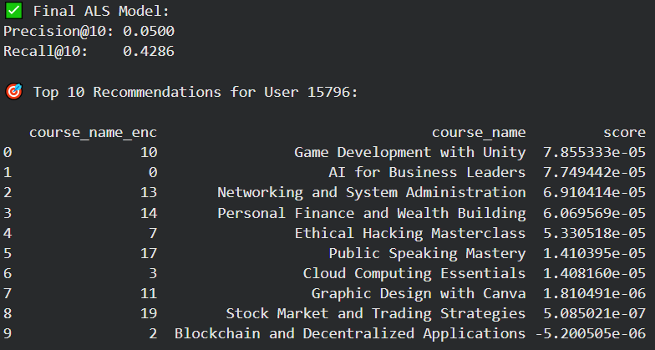
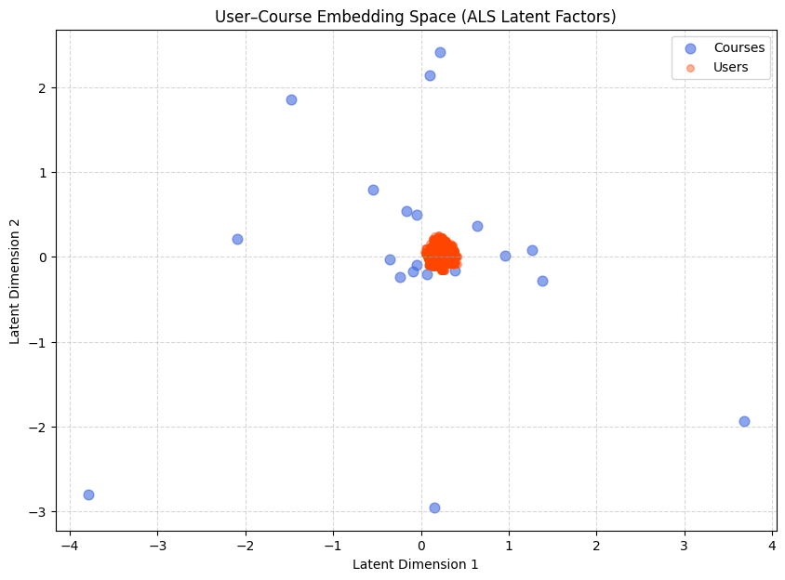
Model Building
1. COLLABORATIVE FILTERING (ALS)

Slide 12
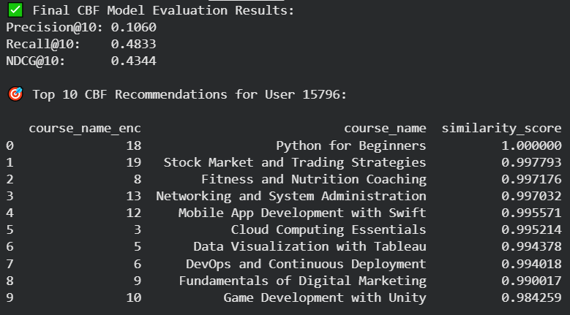
2. CONTENT-BASED FILTERING (CBF)

Slide 13
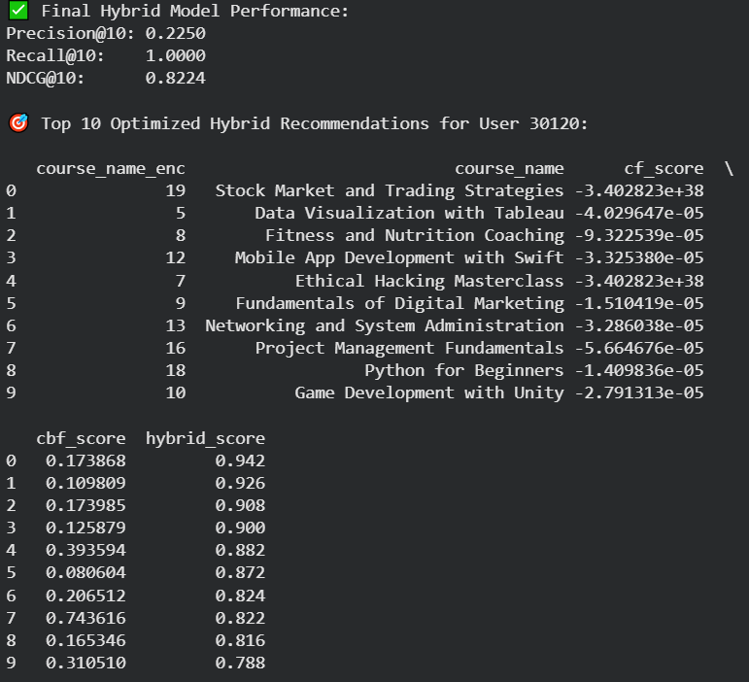
3. HYBRID RECOMMENDER

Slide 14

Deployment

Slide 15
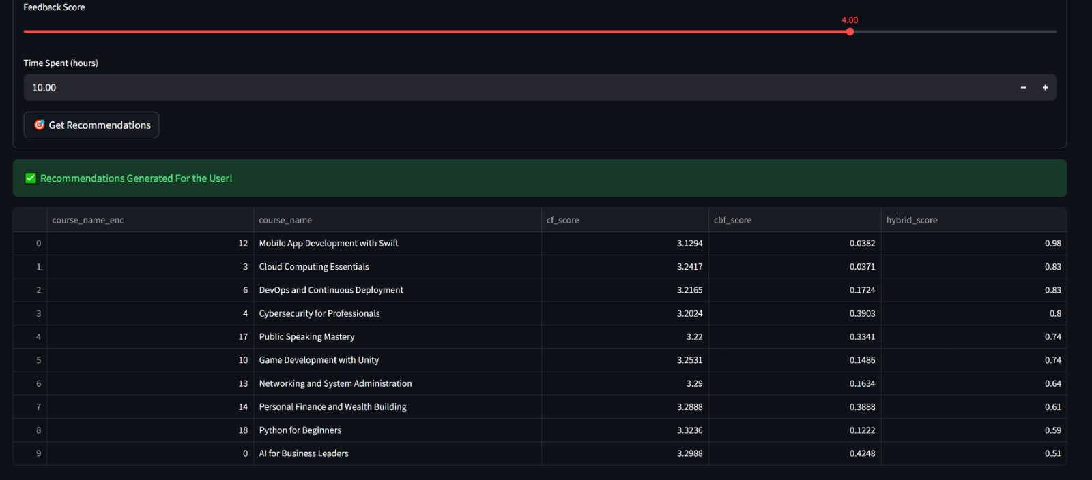

Slide 16

Challenges Faced in Project
Building a robust and effective online course recommendation system comes with several inherent challenges that require careful consideration and strategic solutions.
High dimensionality of course attributes requiring careful feature engineering
Imbalanced engagement patterns affecting model generalization
Multicollinearity among numerical variables influencing model stability
Outlier distortion in duration, price, and time-spent metrics impacting model training
Preventing data leakage during preprocessing and normalization steps
Selecting optimal similarity metrics (cosine, Pearson, distance-based) for recommendation models
Encoding heterogeneous features (categorical, ordinal, textual) into consistent formats
Ensuring scalable computation for large user–item matrices and similarity operations
.

Slide 17
THANK YOU

